Slide 1
Carbonate Fields
Simulation of carbonate reservoirs - 1

Slide 2
Carbonate reservoirs
  Agenda
  Simulation of carbonate reservoirs
    Flow mechanism and Simulation - theory
      Capillary pressure and hysteresis
      Flow mechanics in fractured reservoirs
      Choice of simulation models for fractured reservoirs
      Modelling and simulation of Super-K
      Convergence problems
    Simulation – Application
      Impact of matrix capillary pressure on simulation
      Difference between single porosity and dual porosity simulation
      Modelling and simulation of Super-K
      Key parameters – Impact on recovery
        Oil-Water example
        Oil – Gas example
Part 1
Part 2
June 2010

Slide 3
Capillary pressure and hysteresis
June 2010

Slide 4
Capillary pressure and hysteresis
Definition of Capillary Pressures in the simulator
Pc = Pnwt - Pwt
  Gas always non wetting
  for Water-Oil wettability has to be known
Gas - Oil : Pcog = Pg – Po
Gas - Water : Pcwg = Pg –Pw
Water - Oil : Pcow = Po - Pw by convention in simulators
June 2010

Slide 5
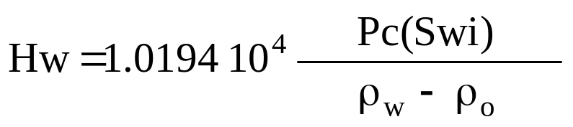
Use of the Capillary Pressure in the simulator
Computation of the initial state of the reservoir
Initial saturation in the reservoir is computed taking into account the equilibrium between gravity and capillary forces
  Important for computation of OOIP
The original fluid migration in a reservoir is a first drainage process
  The simulator must use first drainage Pc curve for OW system
Relation between Pc and transition zone height
bars
kg/m³
m
June 2010

Slide 6
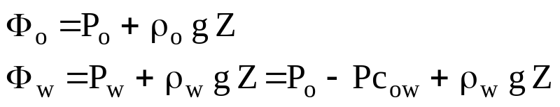
Use of the Capillary Pressure in the simulator
Computation per phase while producing (1/2)
Pc curves are used to compute the phase potentials
Pc curves must correspond to the process represented in the simulation (increase or decrease of the saturation of a “reference” fluid, e.g., water )
Capillary effects are important if :
  Small reservoir thickness
  High Pcmax values
  Gravity and viscous forces are small (low fluid velocity)
  Reservoir is fractured
  Layers with very different permeabilities and in communication
June 2010

Slide 7
Use of the Capillary Pressure in the simulator
Computation per phase while producing (2/2)
Capillary Pressure is sensitive where saturation gradients (front, heterogeneity, digitations) exist
Results in smoothing the fluid front and the digitations if injected fluid is the wetting phase
Positive effect of capillarity on oil recovery if the injected fluid is the wetting phase; detrimental otherwise.
Sensitive on the breakthrough
Acts against gravity
June 2010

Slide 8
Definition of the Hysteresis effect
Must be used to simulate reservoir fluid flow when exist non monotone saturation variation during the field production (drainage, imbibition cycles)
Important W - O transition zone or strong capillary effect in dynamic
Gas storage in aquifer reservoir
Gas injection after water sweeping, tertiary recovery process (WAG)
Variation of the WOC or GOC
Water injection in depleted reservoir having mobile free gas
Can be particularly important in an oil wet (or intermediate oil-wet) reservoir
June 2010

Slide 9
Capillary Pressure - Hysteresis Modeling
The user provides the simulator with tables for drainage and imbibition and selects the type of hysteresis modelisation : Carlson, Killough
The simulator computes
  the residual saturation S_{Nr} linked to the saturation where the
  displacement is reversed (S_{N}^{hyst}) (see curves)
  intermediate curves by weighting between drainage and imbibition Pc = Pcd + F(Pci - Pcd)
F is function
  of the saturation history
  of ε which can be measured and allows to adjust the curve curvature
  ε depends on the facies
The scanning curves may be reversed or not
June 2010

Slide 10
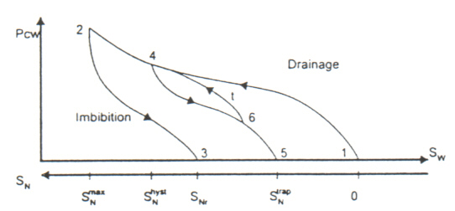


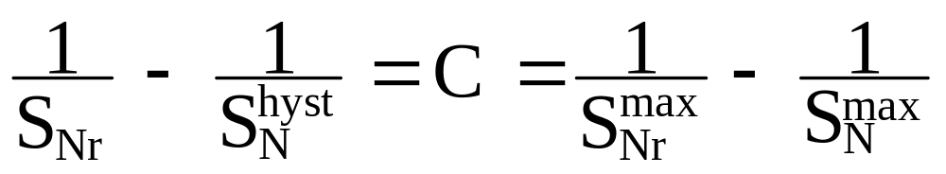
Capillary Pressure - Killough Model (1/4)
Killough model
S_{Nr} is computed by Land formula (as for the Kr)
June 2010

Slide 11
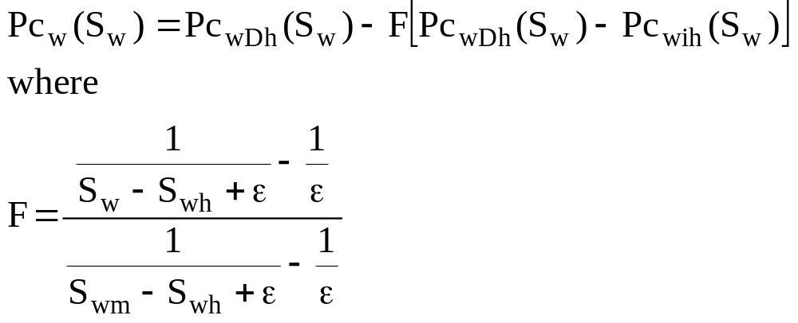

Capillary Pressure - Killough Model (2/4)
Capillary pressures along a drainage-to-imbibition scanning loop
ε :predetermined parameter for the curvature
  typically 0.05 < ε < 0.1
June 2010

Slide 12
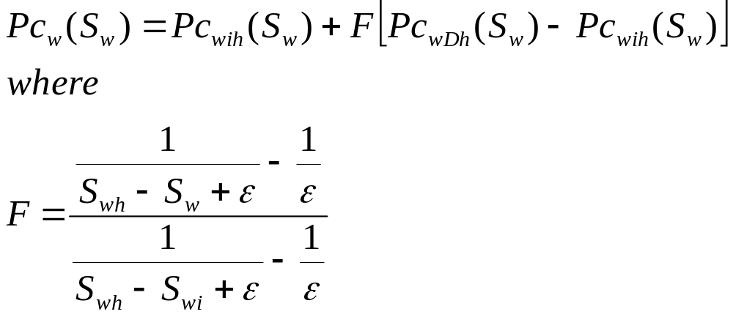
Capillary Pressure - Killough Model (3/4)
Capillary pressures along a imbibition-to-drainage scanning loop
ε :predetermined parameter for the curvature
  typically 0.05 < ε < 0.1
June 2010

Slide 13
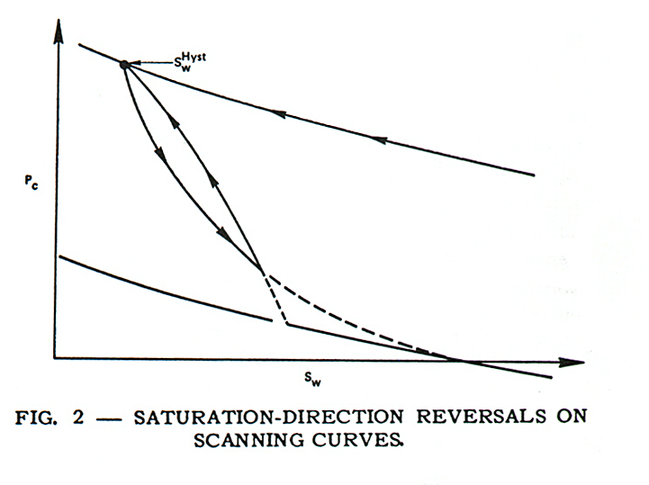
Capillary Pressure - Killough Model (4/4)
Should another reversal in the direction of saturation change occur while the capillary pressure is in a scanning state, a new scanning curve is generated that scans back to the point where the bounding curve was left originally
New interpolating function is used that depends on the new reversal point, the remembered reversal point, the present saturation and the regression parameter
June 2010

Slide 14
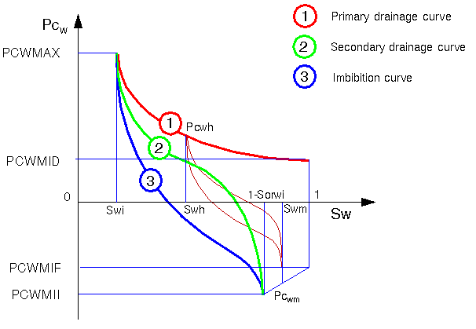
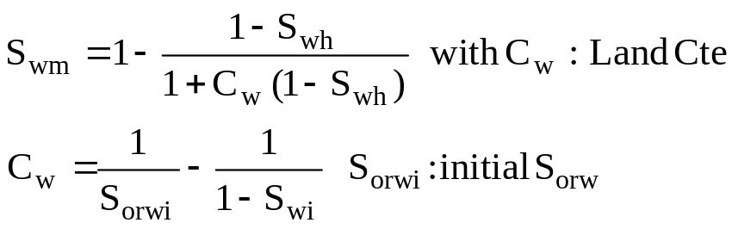
Capillary Pressure - Carlson Model (1/3)
Carlson’s method uses the full imbibition cycle starting at Sw=Swi. It requires 3 curves:
June 2010

Slide 15
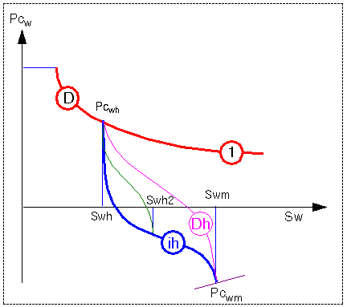
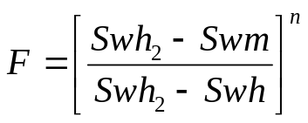


Capillary Pressure - Carlson Model (2/3)
F computed after Thomas Tan*:
  If Swh2-Swh < 0.05 ⇨ F=0
  If Swh2-Swh ≥ 0.05 ⇨
with
and by default
* “Representation of Hysteresis in Capillary Pressure for Reservoir Simulation Models”, Journal of Canadian Petroleunm Technology, July-Aug. 1990, 84-88.
June 2010

Slide 16
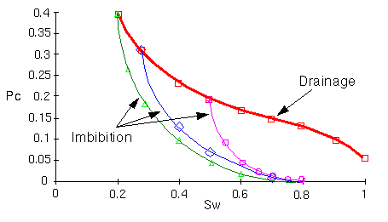
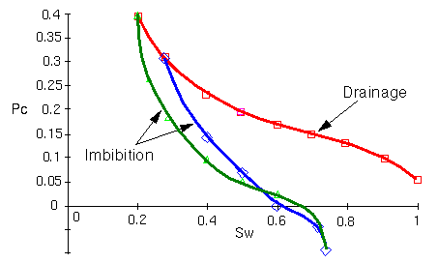
Capillary Pressure - Carlson Model (3/3)
When the end of the initial drainage curve is steep enough and when the imbibition curves include negative values, the imbibition curves starting at Sw > Swi may intersect the main imbibition curve which is against the physics of the phenomenon
Close check of the curves is recommended
May result in errors when computing the recovery by spontaneous imbibition in fractured reservoir
June 2010

Slide 17
Use of the Capillary Pressure in the simulator
Recommendations
Use drainage Pc both for initialization and dynamic simulation
  Only if the transition zone is small so that the effect is negligible in Dynamic (ex Pc imbibition is ≈ 0 or small layer thickness or weakly heterogeneous model)
  Interest
    Data is simpler
    CPU time is lower
Use the hysteresis Pc in other cases
  Input the imbibition Pc curves
  If no measurement estimate imbibition curves going from Pcmax to 0
June 2010

Slide 18




Relative Permeability - Hysteresis Modeling
The user provides the simulator with imbibition and drainage curves
The simulator computes the scanning curves depending of the saturation history
  : non wetting fluid saturation (ex So)
  : maximal residual non wetting fluid saturation (ex Sorw)
  : maximal non wetting saturation (ex 1 with WO)
  : non wetting saturation when the direction of saturation change is reversed (ex drainage to imbibition)
The scanning curves are always reversed
Several available Hysteresis Models Eclipse Killough (kr - Pc) PumaFlow Killough (kr - Pc) Carlson (kr) Carlson (kr - Pc) Norsk - Hydro WAG Fractal WAG
June 2010

Slide 19
Killough model - Computation of the scanning curves
Computation of the trapped non-wetting fluid saturation by Land method
Computation of the scanning curves for the wetting and non-wetting phases between S_{N}^{trap} and S_{N}^{hyst}
June 2010

Slide 20
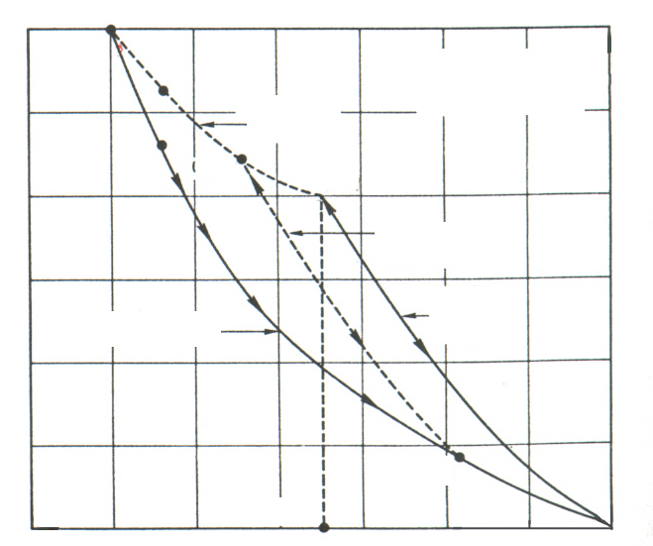






Relative Permeability - Killough Model (wetting phase)
Wetting phase is treated somewhat differently
Computed Imbibition Relative Permeability curves are reversible
Hyst - historical max. S_{N}
S_{N}
S_{Nr}
- Residual non-wetting saturation
Locus of maxima
Killough model predicts the maximum wetting relative permeability by interpolating between the “known” imbibition relative permeability (experimental or parametric curve) at the maximum residual non wetting saturation and the value of the drainage wetting relative permeability at the maximum wetting-phase saturation (trapped non wetting saturation equal to zero or Snc)
K
lm
(calculated)
rw
K
Dr
(Experimen
tal)
(Experimental
or Analytical)
rw
Saturation of the wetting phase
June 2010

Slide 21
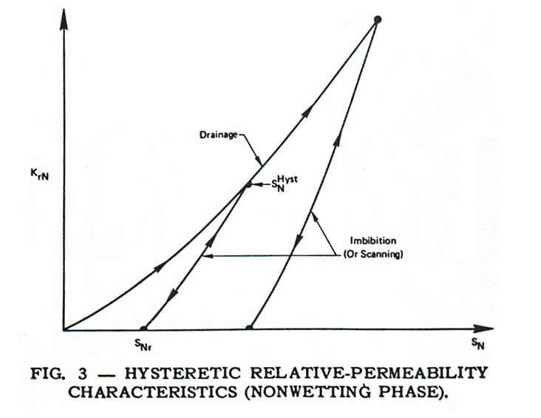
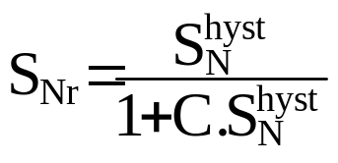
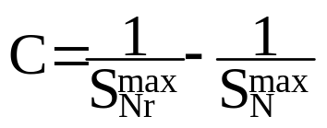




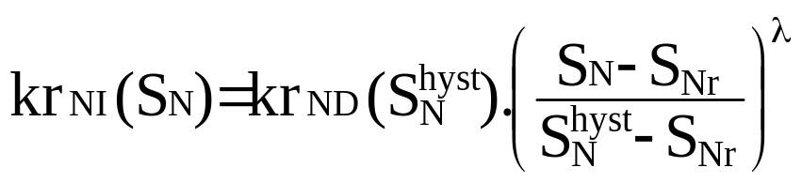
Gas-oil Relative Permeability - Killough Model (non wetting phase)
Parametric interpolation for the scanning imbibition curves (with l given parameter)
June 2010

Slide 22
Relative Permeability - Carlson Model
No hysteresis on the wetting phase, only on the non wetting phase
Compulsory
  Drainage curve
  a minimum of one point on the imbibition curve
  Land’s relationship between the historical maximum and final trapped values of the non wetting phase saturation
Optional
  Imbibition curve
Calculation of the scanning curves Translation of the experimental imbibition curve
June 2010

Slide 23
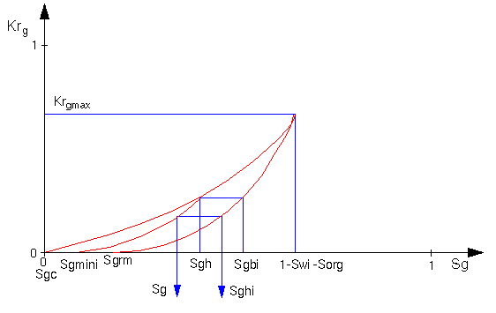
Gas-oil Relative Permeability Hysteresis
Carlson Model (1/2)
Wetting phase relative permeability has no dependence on the trapped non wetting saturation
June 2010

Slide 24
Gas-oil Relative Permeability Hysteresis
Carlson Model (2/2)
Basic drainage curves have to be complemented by a basic imbibition curve starting at the maximum gas saturation of the drainage curve (Sgmax = 1-Swi -Sorg ) and ending at the maximum trapped gas saturation Sgrm
These curves may be input (better way) or computed from the drainage curve. At each point of the drainage curve (Sgd, krgd) corresponds a point (Sgi, Krgi) of the imbibition curve such as:
K_{rgi} = K_{rgd}
    S_{gd} = 0.5 . [(S_{gi}- S_{grm}) + ( (S_{gi}- S_{grm})² + 4/C . (S_{gi}- S_{grm}) )^{1/2} ]
where C is computed from the empirical relationship published by Land with :
    C = 1/S_{grm}- 1/(1-S_{wi}-S_{org})
Scanning curves are automatically generated as Carlson showed that all the imbibition curves starting at any point of the drainage curve should be parallel
June 2010

Slide 25
Recovery process for naturally fractured reservoirs
June 2010

Slide 26
Flow mechanisms in fractured reservoirs
Water
Injection
Depletion
Gas Injection
A
A
A
GOC
WOC
Gravity Drainage
Segregation
+Convection
within fractures
Diffusion
Gas drive
Reimbibition
GOC
WOC
Water drive
Imbibition
June 2010

Slide 27
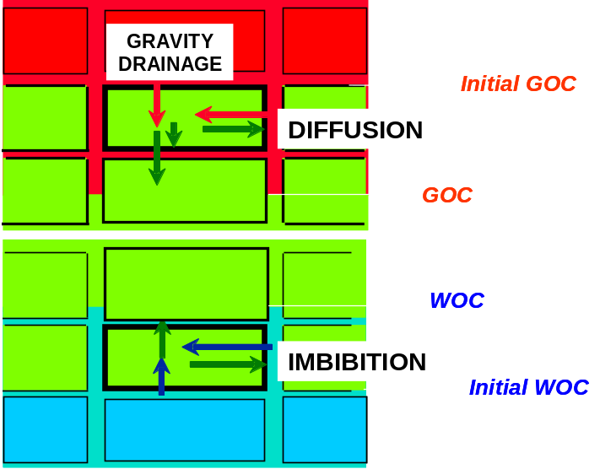
Main flow mechanism during depletion
Flow mechanisms in fractured reservoirs
GOC in fractures
Expansion and gas drive +
Gas segregation within fractures
Convection
in the oil phase
within fractures
S_{g}=S_{gc}
Two-phase expansion
(immobile gas)
P=Pb
Solution gas
diffusion
to fractures
Single-phase expansion
WOC in fractures
S_{g}= Gas saturation
S_{gc} = Critic saturation gas
P = Pressure
P_{b}= Bubble pressure
June 2010

Slide 28
Transfers associated to fluid contact movements
Flow mechanisms in fractured reservoirs
1. WATER DRIVE RESERVOIRS (active aquifer, injection)
  ⇨ Spontaneous (capillary) imbibition and/or gravity effects.
2. GAS DRIVE RESERVOIRS (gas cap expansion, secondary gas-cap, injection)
  ⇨ Gravity drainage.
If (Non-equilibrium) GAS INJECTION:
  ⇨ Compositional effects: thermodynamic transfers (swelling, vaporization), diffusion.
June 2010

Slide 29
Water-Oil matrix-fracture transfer mechanisms
EXPANSION
CAPILLARITY
GRAVITY
VISCOUS DRIVE
O
O
W
W
W
ΔP_{mf}
ΔPc_{mf}
Δρ.g.c
ΔP_{f}
positive/
negative
effects
positive
effects
sometimes
significant
negligible
June 2010

Slide 30
Water-Oil matrix-fracture transfer mechanisms
Drive mechanisms involved in water-oil matrix-fracture transfers:
CAPILLARITY : Pc_{m}>>Pc_{f} ⇨ ΔPc # Pc_{m} = (IFT/r_{p}).f(S_{w})
f(S_{w})= dimensionless Pc (Leverett function;
r_{p} = characteristic pore dimension # (8k/φ)^{0.5} : r_{p} varies as k^{0.5}
GRAVITY : ⇨ Δρ.g.H (gravity head)
H= c (block height) if small blocks or rapid water rise in fractures
H< c if high blocks (or vertical capillary continuity of matrix) or slow water rise in fractures
VISCOSITY : Pressure gradient in fractures ⇨ viscous drive in matrix
June 2010
Notes:
At ΔP=(Pf-Pm)=(ρ_{w}-ρ_{o})gH=0 (if capillary pressure is not taken into account)
At ΔP=(Pf-Pm)=(ρ_{w}-ρ_{o})gc
1
2

Slide 31
Capillarity in water-oil systems
* Water-wet matrix: P_{o}-P_{w} > 0
- water spontaneously sucked
(imbibed) by matrix
- gravity forces do not much affect
the matrix oil recovery process
* Oil-wet matrix: P_{o}-P_{w} < 0
- oil trapped within pores (no water
imbibition)
- only gravity forces enable matrix
oil recovery
* Intermediate (mixed) wettability:
P_{o}-P_{w} > and < 0
- water imbibes partially
- gravity forces enhance oil
recovery
P_{o}-P_{w}
1-S_{orw}
0
oil
S_{w}
P_{o}-P_{w}
1-S_{orw}
water
0
S_{w}
−Δρgc
P_{o}-P_{w}
1-S_{orw}
oil
0
S_{w}
−Δρgc
S_{wi} = irreducible water saturation S_{orw} = residual oil saturation (forced displacement)
June 2010
Notes:
If viscous forces are not taken into account, Pg+Pc=0

Slide 32
Specific studies on spontaneous imbibition
1D laboratory tests on a waterwet sandstone - Effect of boundary conditions
Predominantly
COCURRENT
imbibition
Cocurrent and
countercurrent
(TOTAL) imbibition
COUNTERCURRENT
imbibition
W
W+O
O
W
W+O
W
W+O
W
W+O
Ref. : B. Bourbiaux and F. Kalaydjian: "Experimental study of cocurrent and countercurrent flows in natural porous media",
SPE Reservoir Engineering, Aug. 1990.
June 2010

Slide 33
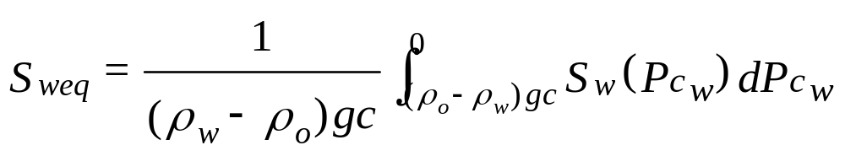
Ultimate recovery from a block immersed in water
Water-Oil matrix-fracture transfer mechanisms
Average water saturation of the matrix block at the equilibrium between gravitational and capillary forces the end of imbibition (and drainage) by water:
Oil recovery from matrix block= (S_{weq} - S_{wi}) / (1-S_{wi})
c
P_{o}-P_{w}
trapped
oil
z
S_{w}
water
0
0
−Δρ_{ow}gc
Block fully immersed in water
June 2010

Slide 34
Assessment of oil production from water-drive
Water-Oil matrix-fracture transfer mechanisms
Water-Oil matrix-fracture transfer mechanisms
• Driving forces: capillarity (if matrix is water-wet) and gravity
• Countercurrent and cocurrent flows
• Main parameters: - rock-fluid wettability properties
        - block dimensions (a,b,c) and matrix permeability (k_{m})
        - block boundary conditions (speed of WOC rise)
  Ultimate recovery = f(Pc curve, gravity head Δρgc)
  Production kinetics = f((a,b,c), km, Pc, Mobilities k_{r}/µ)
NECESSARY Lab. information:
+ Complete P_{c} curve (P_{c}'s > and < 0)
+ Relative permeability curves
P_{o} -P_{w}
S_{w}
0
−Δρgc
June 2010

Slide 35
Water-Oil matrix-fracture transfer mechanisms
Assessment of oil production from water-drive
Important reservoir information:
+ For non-water-wet rocks, block height estimation and capillary continuity
assessment is a prerequisite to evaluate oil recovery
+ Assessment of fracture-to-matrix permeability ratio: if not very high, viscous
pressure drops in fractures will enhance oil recovery (forced displacement
within matrix)
Concerning field process implementation: the production scheme and constraints have to be optimized to synchronize the rate of water-oil contact rise within fractures and the rate of matrix desaturation.
June 2010

Slide 36
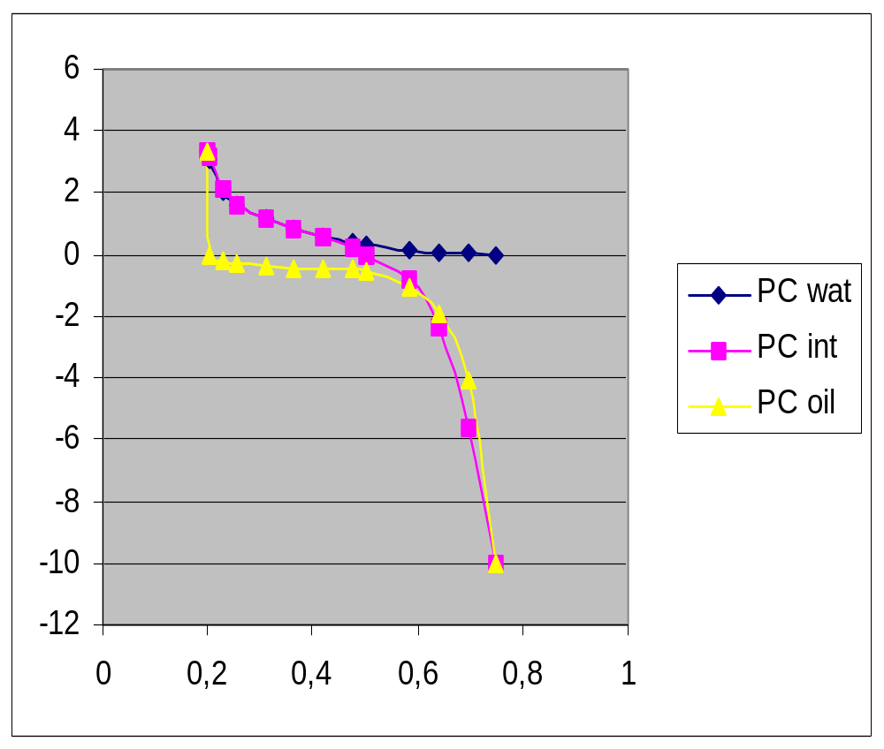
Influence of block shape on recovery
WATER/OIL - MATRIX CAPILLARY PRESSURE CURVES
Capillary Pressure (bar)
Water Saturation
June 2010

Slide 37
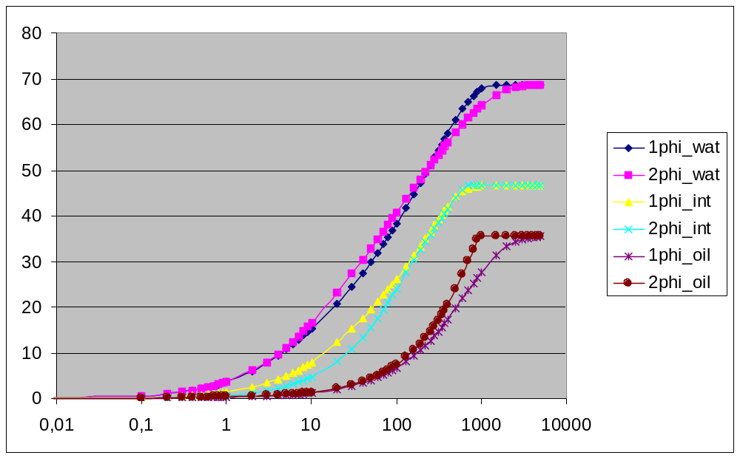
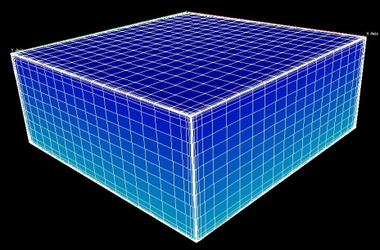
Influence of block shape on recovery
WATER/OIL - SINGLE VS DOUBLE POROSITY MODELS
One matrix block
Water wet
Intermediate
wet
Recovery Factor (%)
Oil
wet
Time
June 2010

Slide 38
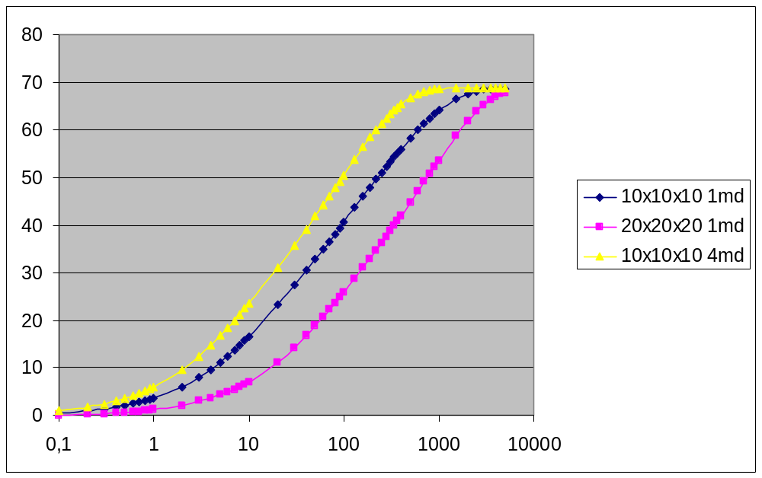
Influence of block shape on recovery
WATER/OIL - K AND BLOCK SIZE - WATER WET
Recovery Factor (%)
4
1
1
T₅₀ = 27
T₅₀ = 220
T₅₀ = 55
Time
June 2010

Slide 39
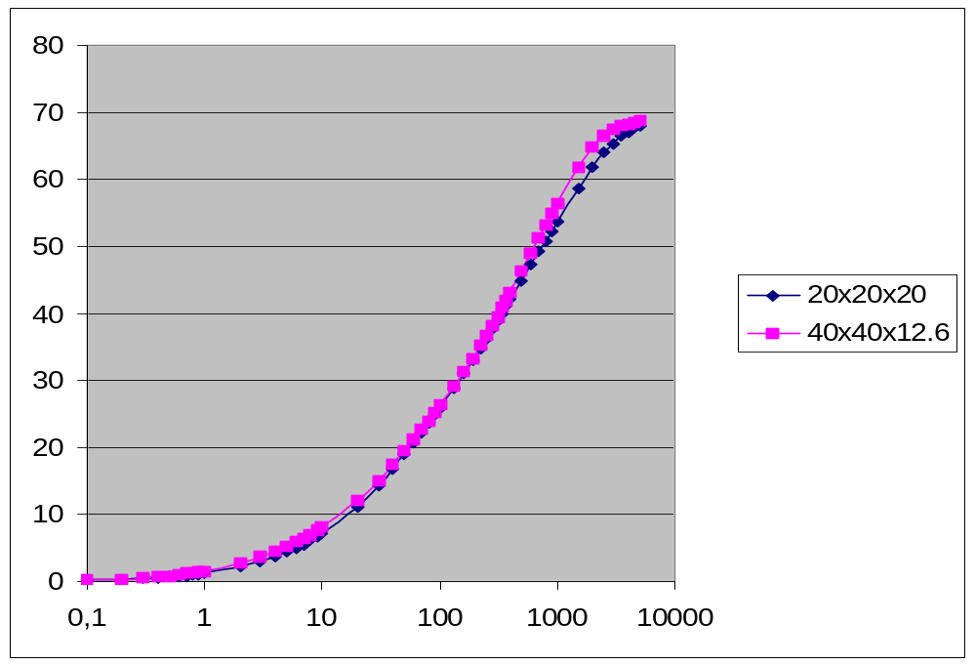
Influence of block shape on recovery
WATER/OIL - SHAPE FACTOR - WATER WET
SHAPE FACTOR σ = 4 * (1/a² ⁺ 1/b² ⁺ 1/c² ⁾
a = b = c = 20, σ = 0.03
a = b = 40, c = 12.6, σ ≈ 0.03
Recovery Factor (%)
Time
June 2010

Slide 40
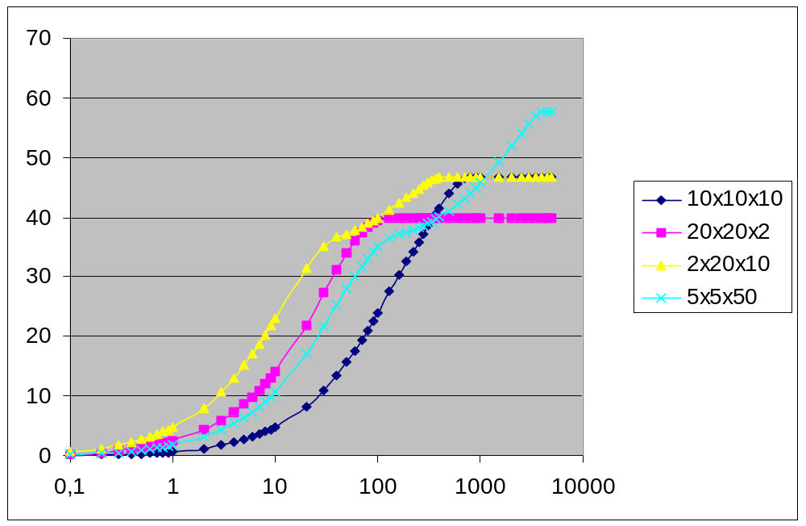
Influence of block shape on recovery
WATER/OIL - BLOCK SHAPE - MIXT WET
5 x 5 x 50
2 x 20 x 10
Recovery Factor (%)
20 x 20 x 2
10 x 10 x 10
Time
June 2010

Slide 41
Water drive in fractured reservoirs
Favourable criteria
Isotropic horizontal fracture permeability; good knowledge of this anisotropy if any
Water wettability
Small blocks (horizontal dimensions)
Long matrix block
Low μ_{o}
Good matrix permeability
Unfavourable criteria
Non-identified horizontal fracture permeability anisotropy
Oil wettability
Large matrix blocks (horizontal dimensions)
Short matrix block
High μ_{o}
(Very) low matrix permeability
June 2010

Slide 42
Gas-Oil matrix-fracture transfer mechanisms
EXPANSION
GRAVITY
CAPILLARITY
VISCOUS DRIVE
DIFFUSION
G
G
ΔP_{mf}
Δρ.g.c
ΔPc_{mf}
ΔP_{f}
ΔC_{mf}
significant
if P<Pb
positive
effects
negative
effects
negligible
sometimes
significant
June 2010
Notes:
At ΔP=(Pf-Pm)=(ρ_{o}-ρ_{g})gH=0 (if capillary pressure is not taken into account)
At ΔP=(Pf-Pm)=(ρ_{o}-ρ_{g})gc
1
2

Slide 43
Capillarity in gas-oil systems
- Liquid (oil) always wetting
- Gravity alone is the driving mechanism of oil recovery
- capillary forces always counteract gravity forces
- There exists a minimum pressure
(displacement pressure P_{d}) below which gas cannot enter the matrix
- Matrix blocks having a height lower than c_{min}= P_{d}/Δρg cannot be drained at all.
P_{g}-P_{o}
Δρgc
P_{d}
S_{g}
0
1-S_{org}-S_{wi}
gas
S_{org} = residual oil saturation
S_{wi} = irreducible water saturation
June 2010

Slide 44
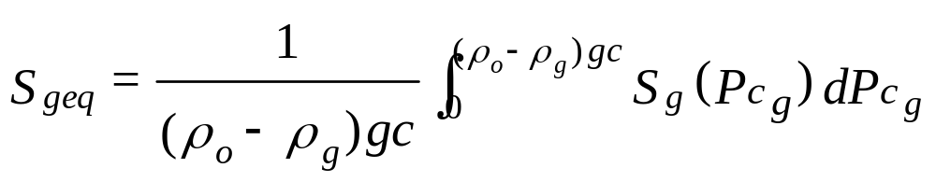
Ultimate oil recovery by gravity drainage
Average gas saturation of the matrix block at the equilibrium between gravitational and capillary forces at the end of gas-oil drainage:
Oil recovery from matrix block = S_{geq} / (1-S_{wi})
0
P_{g}- P_{o}
z
Gas
Δρ_{og}gc
P_{d}
S_{g}
Trapped oil
0
c
Block fully immersed in gas
June 2010

Slide 45
Capillary continuity and gas-oil gravity drainage
Existence of porous bridges between superposed blocks (= capillary
continuity) has two effects:
1. The oil can flow from one block to another: the effective block
height controlling the final oil recovery from the stack of blocks
is equal to the height of the stack;
2. The interfaces between superposed blocks form flow restrictions:
the kinetics of drainage of the stack is less than that of a single
block of equivalent height.
Capillary
continuity
c
Effective
height=2c
c
(c= vertical distance between 2 fractures)
June 2010

Slide 46
Impact of heterogeneities on gravity drainage
Flow barriers may exist within the matrix medium (impermeable beds),
with the following consequences:
⇨ the effective block height is reduced (lower matrix oil recovery)
⇨ the oil produced from the upper blocks into the fractures just
above the barrier(s) may reimbibe the lower blocks if already drained
by gas (this reimbibition phenomenon will not be significant if
matrix desaturation follows GOC movement in fractures).
Flow
barriers
(k_{m}=0)
Oil
reimbibition
c
Effective block
height= c/4
(c= vertical distance between 2 fractures)
June 2010

Slide 47
Impact of capillary continuity on gravity drainage
Experiment on a stack of 3 blocks: c₁> c_{min} ; c₂ < c_{min} ; c₃ > c_{min}
(c_{min} : height of capillary holdup zone)
Dynamics
of drainage
Gas
Final Sg profile
c₃
3
Sgmax
c_{min}
flow-restricted
porous bridges
Oil
c₂
c_{min}
2
c₁
1
c_{min}
c_{min}
June 2010

Slide 48
Assessment of oil production from gravity drainage
• Driving force: gravity (adverse effect of capillary forces)
• Main parameters: - block height (c) and cross-section (if lateral gas invasion)
        - matrix permeability (k_{m})
        - capillary curve
  Ultimate recovery = f(Pc curve, gravity head Δρ_{og}gc)
  Production kinetics = f(c, (a,b), k_{m}, Pc, Oil Mobility k_{ro}/µ_{o})
NECESSARY Lab. information:
+ PVT data, including IFT versus P
+ Pc curve (depending on IFT)
+ Relative permeabilities (end-points, shape)
P_{g}-P_{o}
Δρ_{og}gc
S_{g}
0
June 2010

Slide 49
Assessment of oil production from gravity drainage
Important reservoir information:
+ Assessment of the effective block height (vertical capillary continuity of the matrix, horizontal flow barriers) is a prerequisite to evaluate oil recovery by gas-oil gravity drainage
+ Horizontal flow barriers or restrictions within the matrix also control the recovery kinetics (lateral dimensions of matrix blocks may then play a significant role)
+ The field production strategy (pressure maintenance or depletion) controls gas drive efficiency.
+ The contribution of convection and diffusion phenomena has to be estimated (from production history, PVT,...) for well-fractured reservoirs and for small-blocks reservoirs subjected to an external gas drive.
June 2010

Slide 50
Influence of block shape on recovery
GAS/OIL - SENSITIVITY RUNS : BLOCK HEIGHT and MATRIX PERMEABILITY
60,00
50,00
Final recovery depends on Block height
40,00
Kinetics improves with
Matrix permeability increase
Recovery Factor (%)
30,00
20,00
10,00
here c < c_{min}
0,00
0,01
0,1
1
10
100
1000
10000
100000
Time
June 2010

Slide 51
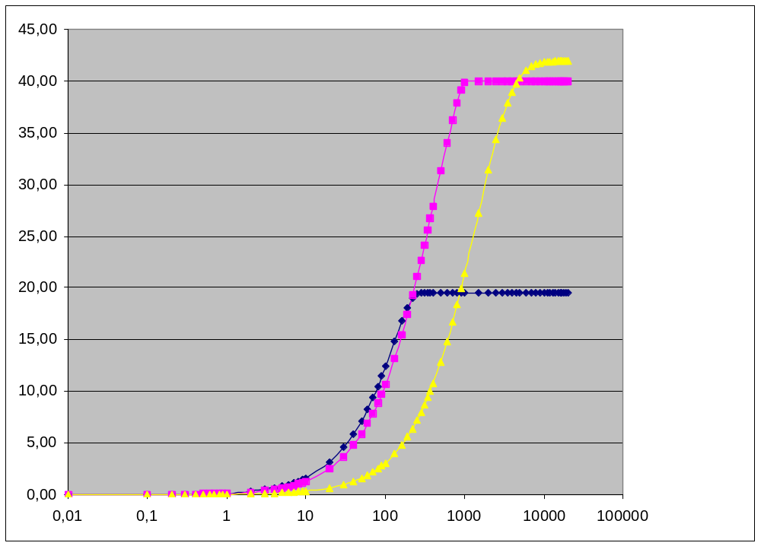
Influence of block shape on recovery
GAS/OIL - INFLUENCE OF THE MATRIX BLOCK SHAPE
5 x 5 x 50
2 x 20 x 10
Recovery Factor (%)
20 x 20 x 5
Time
June 2010

Slide 52
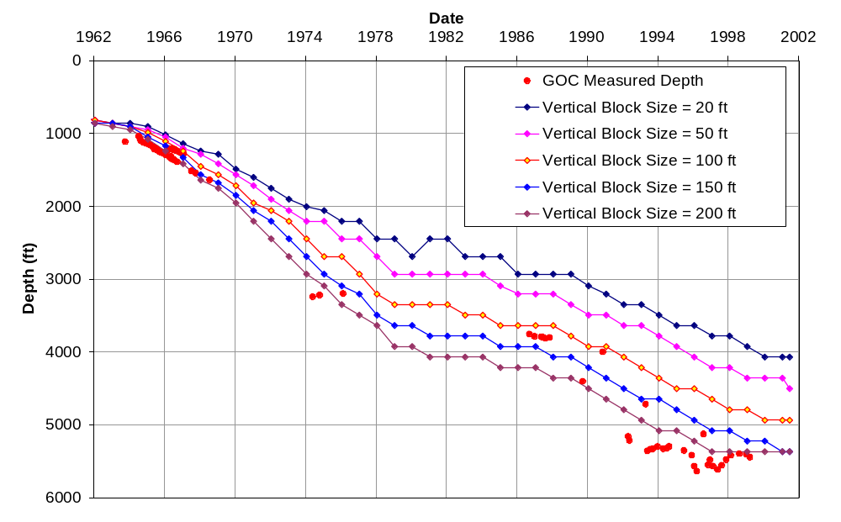
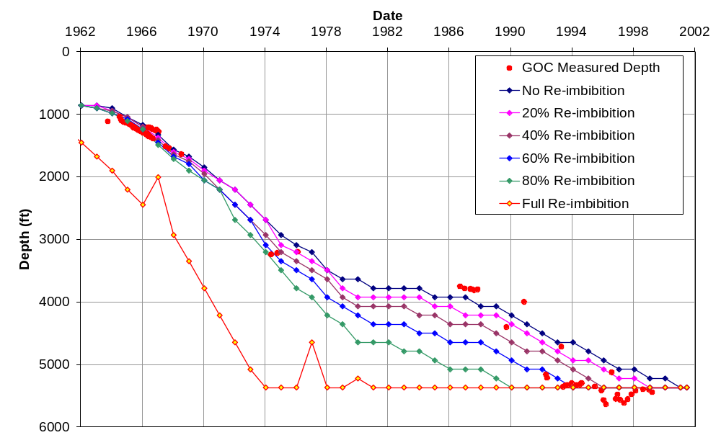
Influence of Block size and Re-imbibition on Recovery
Impact of vertical block size and block to block re-imbibition ratio on gas oil contact
b
a
Oil
reimbibition
Gas
c
Oil
SPE 93760 – Iranian giant field
June 2010

Slide 53
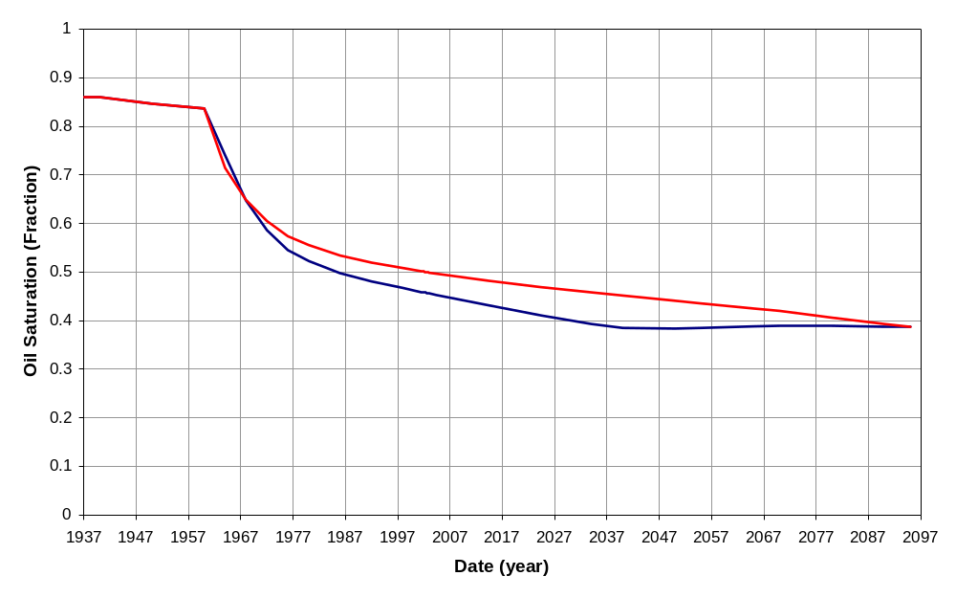
Influence of Block size and Re-imbibition on Recovery
Matrix oil saturation in a selected cell
Fast Kinetic
Slow recovery
So = 1-Swi (14%)
C= 80 ft
α = 20%
C= 20 ft
α = 85%
So = Sorg (25.6%)
History Match
Forecast
SPE 93760 – Iranian giant field
June 2010

Slide 54
Gas drive in fractured reservoirs
Favourable criteria Unfavourable criteria
- High fracture permeability - Low fracture permeability
(especially vertically);
- Thick oil column - Thin oil column
- Large block height - Small block height and/or presence
(capillary continuity, no barriers) of horizontal permeability restrictions
(high matrix permeability anisotropy)
- Low μ_{o} - High μ_{o}
- Good matrix permeability - (Very) low matrix permeability
June 2010

Slide 55
Fractured Gas Reservoirs
EXPANSION
GRAVITY
CAPILLARITY
VISCOUS DRIVE
G
G
G
G
W
W
ΔP_{mf}
Δρ.g.c
ΔPc_{mf}
ΔP_{f}
positive
effect
positive
effect
positive
effect
negligible
The presence of an active aquifer (or water injection) can reduce the overall recovery (depletion drive Vs. Water drive).
June 2010
Notes:
Modeling and Simulation of Naturally Fractured Reservoirs
EAGE Shiraz 2009
At ΔP=(Pf-Pm)=(ρ_{o}-ρ_{g})gH=0 (if capillary pressure is not taken into account)
At ΔP=(Pf-Pm)=(ρ_{o}-ρ_{g})gc
1
2

